Slide 1
Human Machine Interaction
Operating Systems
Notes:
YOU NEED THIS MUCH SPACE ON ONE LINE FOR NOTES
Introduce yourself,
Introduce the Project
Operating Systems and their role in
Human Machine Interaction

Slide 2
Progress of User Interfaces
Presentation Plan
Main System Components
Questions Welcome
Notes:
We will cover the development of the User Interface
Questions Welcome

Slide 3
The Purpose of Computers
Is to improve the lives of Humans. By making Humans more Productive
And by Automating Mundane Tasks
Notes:
Anybody interested in Computers,
They know what an Operating System is
They know what means to take on a project like this
It’s the pinnacle of achievement in Software
How can something so essential to computing have so few serious examples?
Ask around and you’ll be told that it’s because they’re too complicated.
They get scared off I guess
To me that’s not a good answer

Slide 4
1948
Batch Processing
The role of the Operating System was filled by Human Operators. Users submitted jobs to be executed
Notes:
Operating Systems have been central to Computing
since Corbato first introduced Time Sharing, in 1962
Prior to this Batch Processing was used,
the role of the Operating System was filled by a human called an Operator
These systems provided minimal support
for the most part programmers took on the responsibility of managing resources

Slide 5
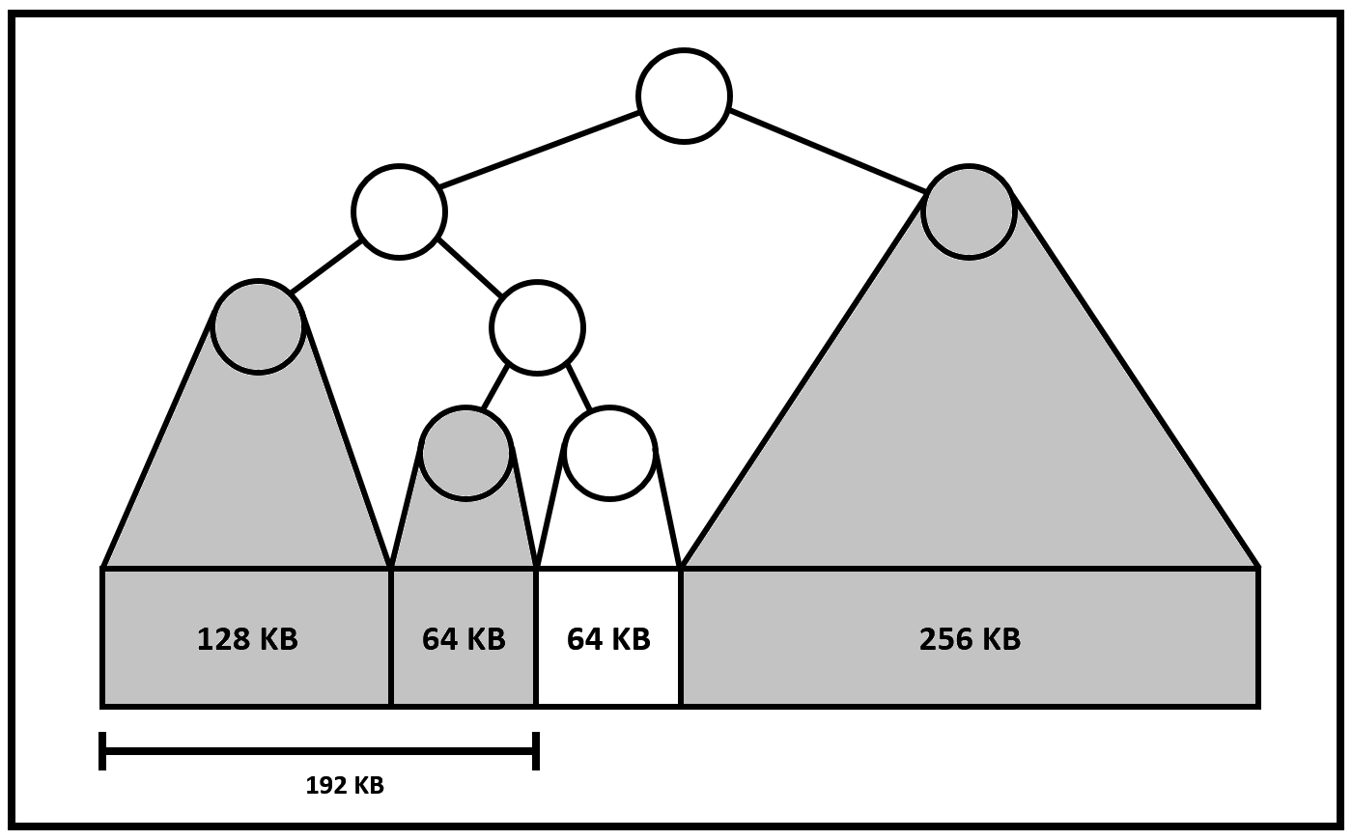
Buddy System Memory Management
Notes:
Here’s an example of a memory manager which appeared at this time
presented by Knuth in the Art of Computer Programming
This system is called the Buddy System
It takes the entire footprint of memory
and represents it as a binary tree called the Heap
By successively dividing memory in half,
eventually you arrive at a block,
just large enough to meet the request

Slide 6
1962
Time-Sharing
Allowed multiple users to interact directly with the system through remote terminals
Notes:
Under the Batch Processing System
The user interface amounted to going to the Computer Room
and handing punched cards to the operator.
The operator who would schedule these jobs for execution,
and the user would later return to collect the results
Corbato showed that this system could be automated,
The result was a multi-tasking environment called Time Sharing
Under this system all resources, including time, are shared between users
Users who previously submitted cards to an operator
where now interacting directly with the computer
Through remotely connected terminals

Slide 7
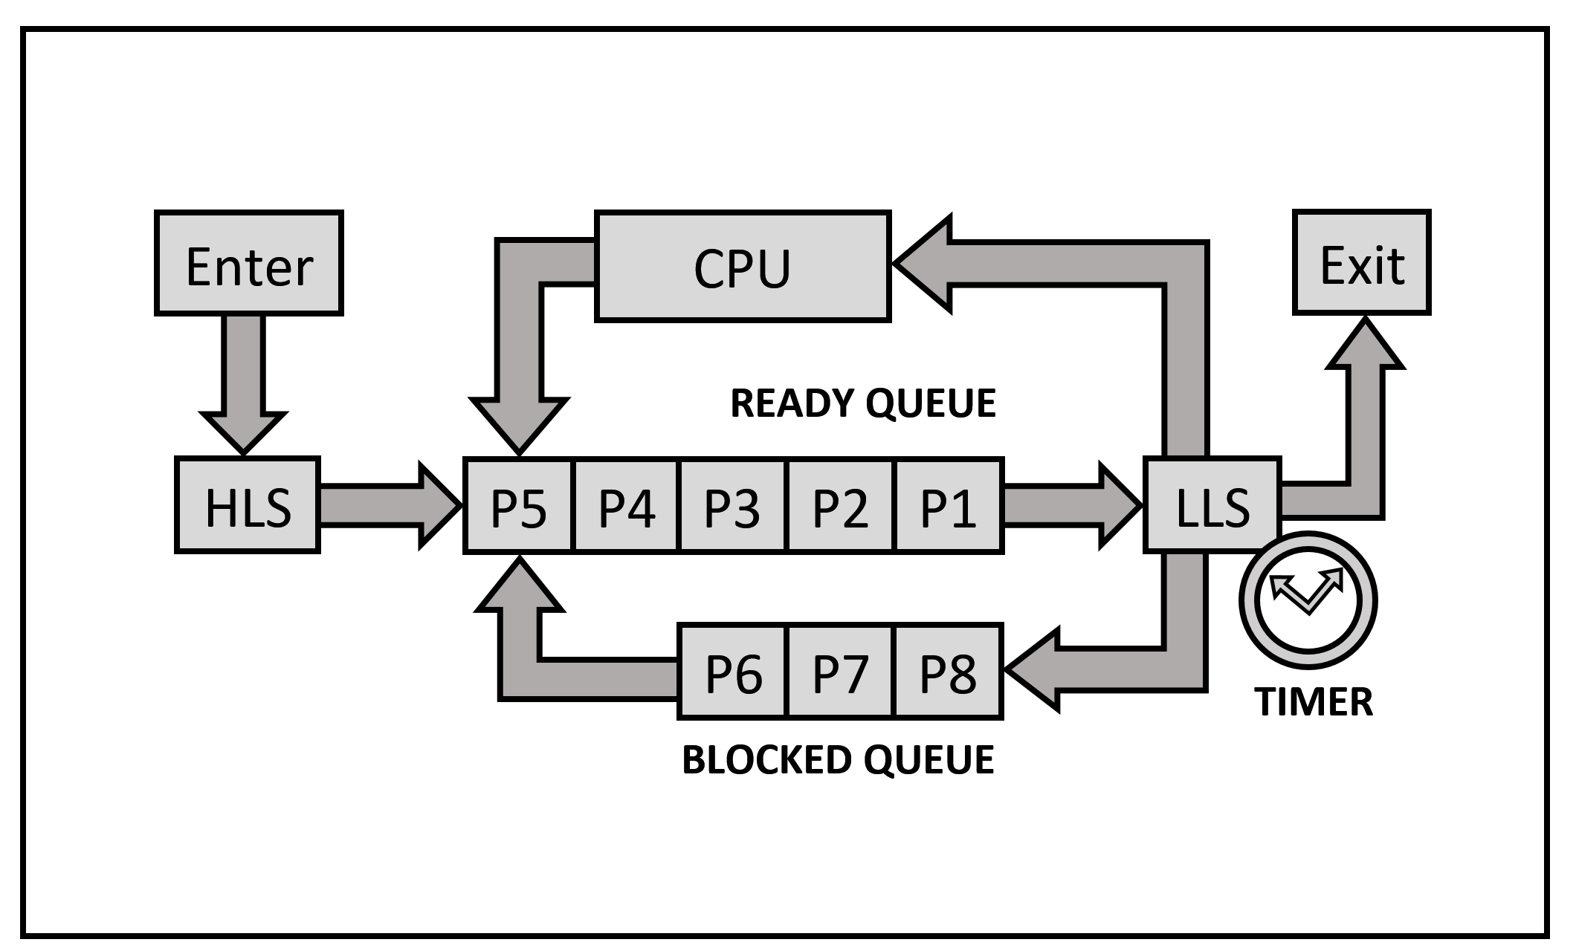
Round Robin Scheduling
Notes:
In a scheduling system, such as the one depicted
there is a ready queue and a blocked queue.
Part of the system called the High-Level Scheduler (HLS),
is responsible for admitting processes to the system.
The HLS performs the strategic process scheduling algorithm.
Another part of the system, called the Low-Level Scheduler (LLS),
is responsible for taking processes from the ready queue
and moving them into a running state.
This allows other processes in the ready queue to advance.
When a process has completed, it can exit the system.
If a process cannot continue, because it is waiting for input or output,
it is moved to the blocked queue.
When a blocked process gets the services that it was waiting for,
it can re-enter the ready queue.
In a Round Robin scheduling system,
each process gets a time slice in the running state,
after which it is placed at the end of the ready queue.

Slide 8
1971
UNIX Pipelining
Promoted textual data, allowed users to solve tasks by themselves, without having to learn how to Program.
Notes:
In 1971 Ken Thompson and Dennis Ritchie
Produced the first version of UNIX.
Ritchie took on the Kernel,
but Ken did most of the rest
Ken is mister UNIX
UNIX promoted the use of generic textual data
To promote data interchange between utility programs
The revolutionary UNIX Shell
allows users to direct the flow of data through a chain of utilities
This allows users to solve new tasks from existing programs
Without having to learn how to program

Slide 9
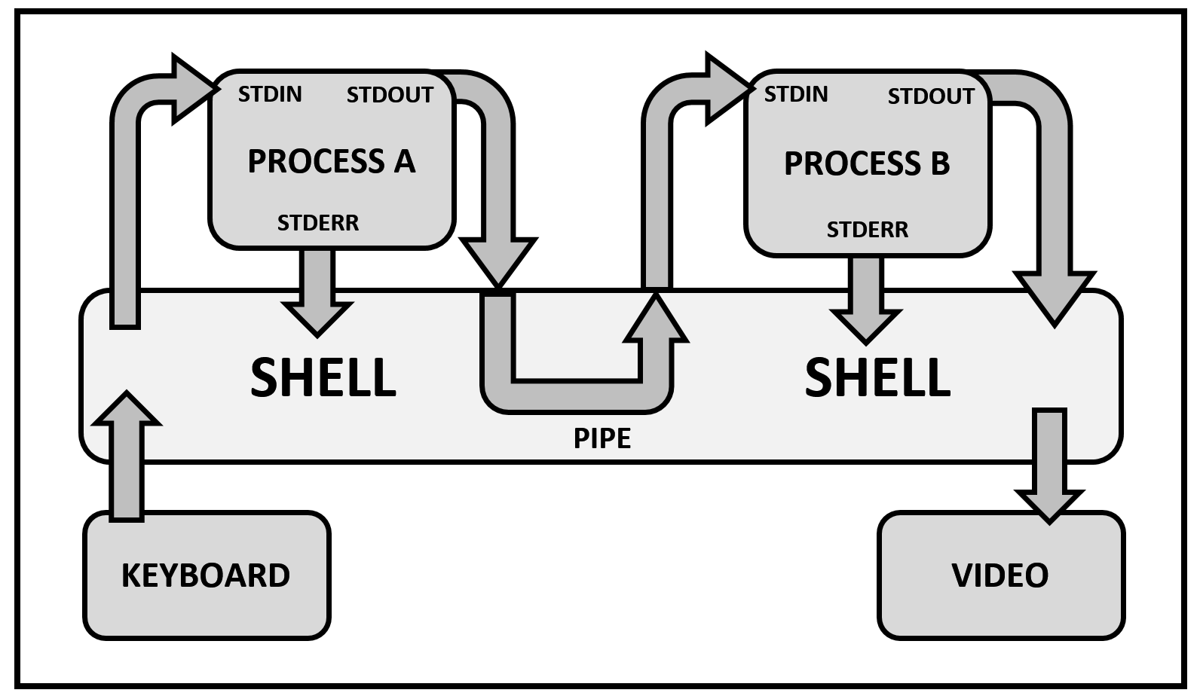
Shell Pipelining
Notes:
Thompson defines the Shell as a command line interpreter,
it reads user typed commands
and interprets them as requests to execute programs.
Each command contains references to multiple programs
which together perform a unit of work.
These programs form a pipeline through which data flows.
In this example the keyboard provides a stream of data
which passes through two programs
to produced output destined for the screen.
The Shell controls this flow of data through the use of Pipes

Slide 10
1973
Xerox Alto
First Graphical User Interface.
Allowed Humans to speak to Computers on Human terms
Notes:
The main limitation of the command line interface is its barrier to entry.
Proficient use of the CLI requires prior knowledge of a wide range of utilities.
Further, this approach requires effort to figure out the appropriate commands.
This is unsuitable for the public who have limited interest in such technical pursuits.
A more intuitive approach is required to meet the needs of the public.
This problem inspired researchers from the Palo Alto Research Centre (PARC)
to develop a system which placed the user first.
This resulted in the first graphical user interface, the Xerox Alto, which was release in 1973.
The user interface is the part of the system which a human interacts with.
When an interface is comfortable and intuitive, human effort is minimized.
By reducing physical and mental effort, productivity is increased.
Graphical User Interfaces take these principles and apply them to operating systems.

Slide 11
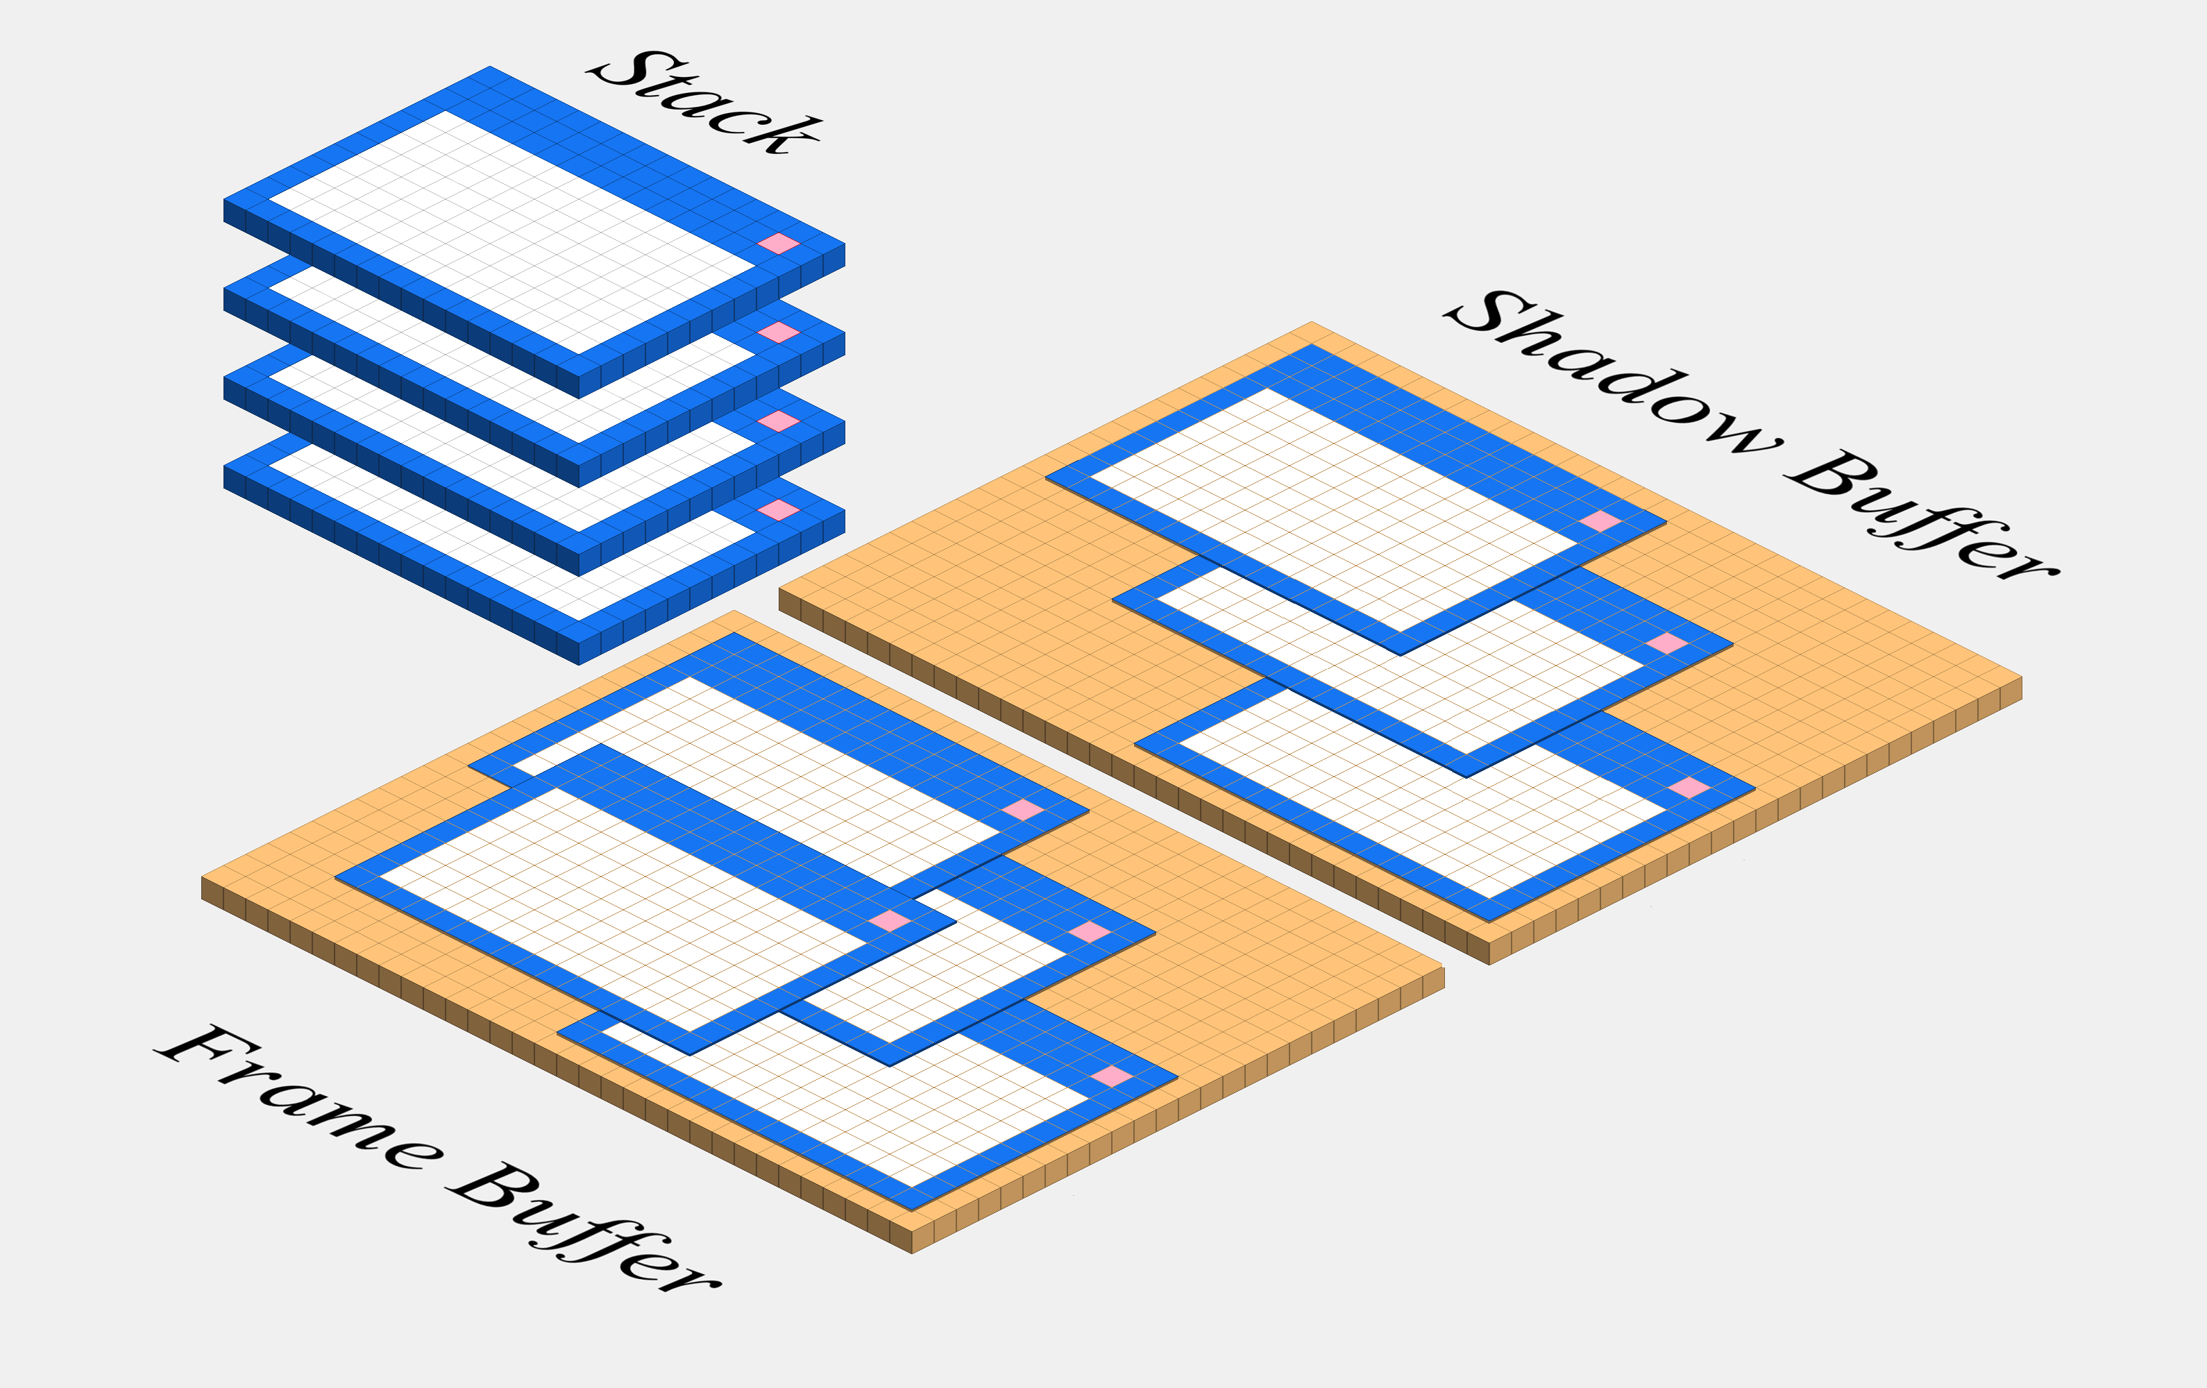
Stacked Windowing System
Notes:
The heart of the Graphical User Interface is a windowing system
In a stacked windowing system
The topmost window serves as
a single point of interaction for the user
All the other windows are put to sleep
Until the user brings those windows to the front
The windowing system takes user input from the
Keyboard and mouse, and converts these to
Appropriate commands which the Shell can execute
Feedback is presented to the user by drawing to the screen

Slide 12
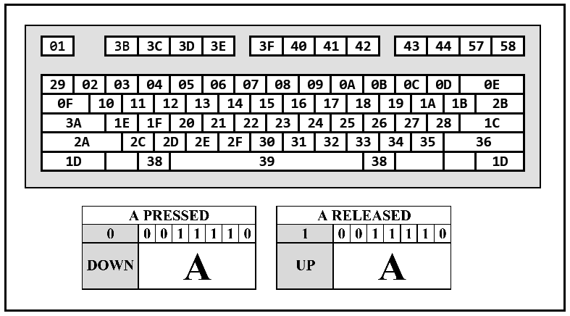
The Keyboard
Notes:
In command line interfaces the keyboard is the primary source of human input
Communicating with the keyboard requires monitoring keystroke events
which the keyboard reports to the system in the form of scan codes.
In this system each key on the keyboard is given a 7bit number
In addition to this a single bit is used to represent
whether a key has been pressed or released
The Operating System is responsible for translating these numbers
into appropriate character encodings such as ASCII

Slide 13
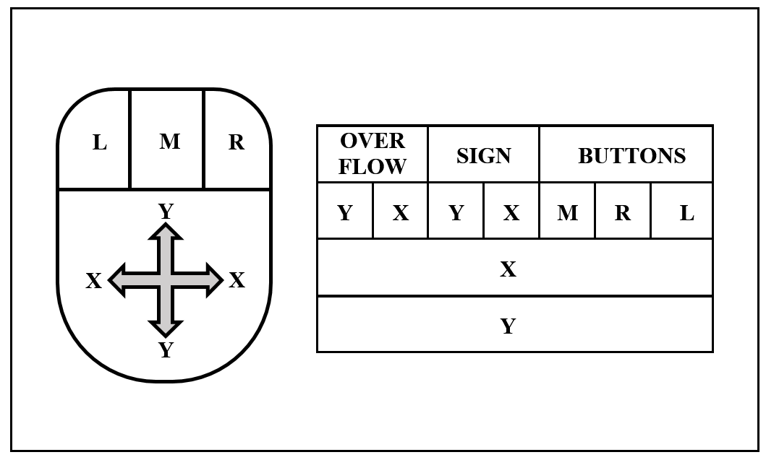
The Mouse
Notes:
In a Graphical User Interface the primary source of Human Input is the Mouse
The mouse communicates with the system by sending three byte packets.
The first byte reports button states, followed by X and Y movements
These X, and Y movements are relative to the previously reported position
There is no correlation between the values reported by the mouse
And the screen resolution
The system is responsible for translating these movements into absolute co-ordinates

Slide 14
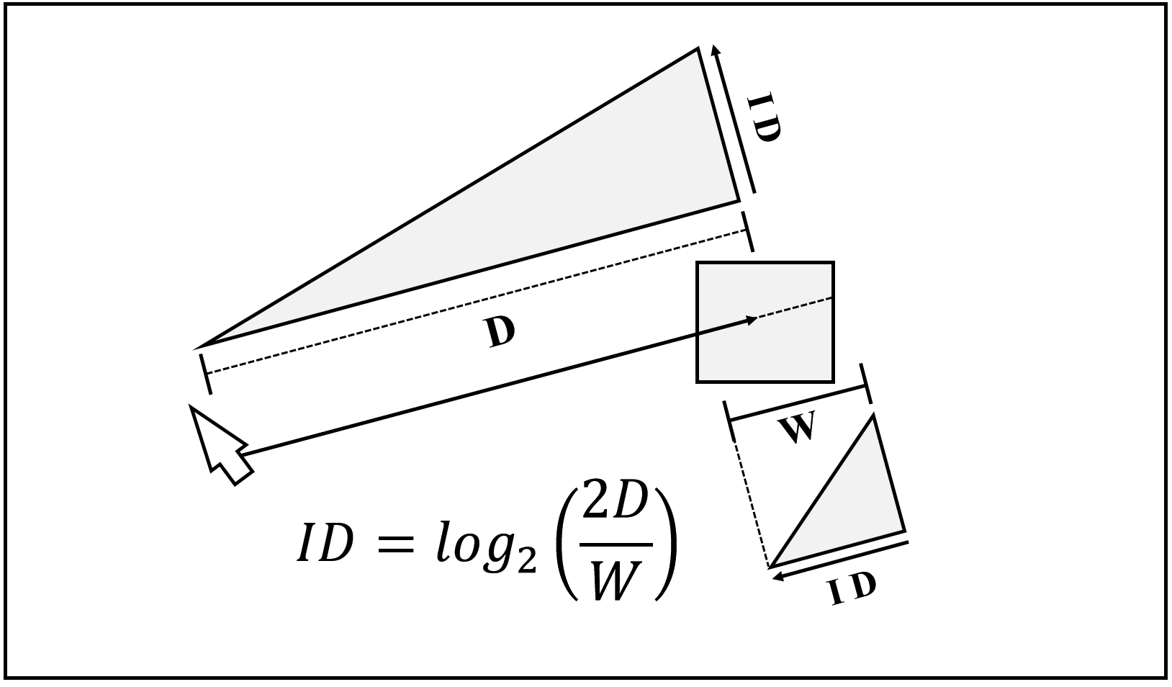
Fitts’s Law
Notes:
This process involves applying Fitts’s Law
Fitts shows that the ability of a human to move an object
From one location to another is a function of the distance
And the width of the landing zone
Exaggerating mouse movements has the effect of reducing
The distance to the target
Simulating inertia, and momentum allows precise refinements
to correct mouse positions
Together these give a more natural feel allowing
muscle memory to drive the mouse

Slide 15
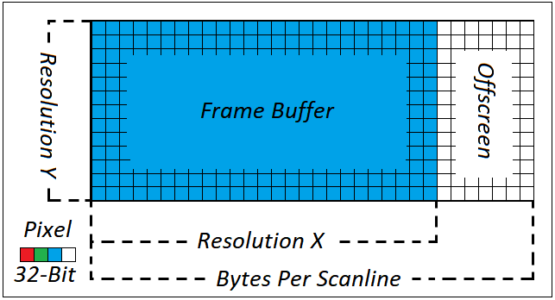
VESA Video Display
Notes:
Rendering pixels to the screen requires
communicating with the display adapter
The VESA standard provides a means of
Controlling video displays
VESA uses memory mapped IO
This allows the system to treat video memory
As though it were convention RAM

Slide 16
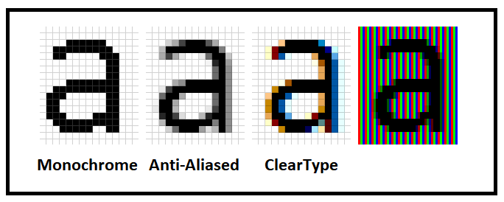
Rasterization
Notes:
The process of converting text to pixels
is known as Rasterization
Getting this right is essential
to eliminate eye strain and fatigue
Here are three different approaches
Monochrome is on the left,
and is most suitable for low resolution displays
Where any attempt to de-pixelate the image
Would result in decreased clarity
ClearType is a patented approach used by Microsoft
Pixels are made up of separate red green and blue sub pixels
ClearType manipulates these sub pixels to create sharper edges
The Anti-Aliased approach is a compromise to ClearType

Slide 17
Questions?
Notes:
Thank the audience for their time
And invite questions

